Slide 1
Predicting Accident Severity in Wake County
Milestone 5
DSC 630
Srilakshmi Bodduluru

Slide 2
Problem statement
Utilizing exploratory data analysis and predictive modelling to predict the accident severity.
Accurate predictions of severity can provide crucial information for emergency responders to evaluate the severity level of accidents, estimate the potential impacts, and implement efficient accident management procedures.

Slide 3
Plan of action
Data Preparation & Exploratory Data Analysis:
Understand Business Objective
Define Modeling Goals
Select/Get Data
Prepare Data
Analyze and Transform Variables. Random Sampling
Modeling:
Model Selection and Develop Models (Training)
Validate Models (Testing)

Slide 4
Data Sources
Data source: US_Accidents_Dec19.csv from kaggle datasets.
This is a countrywide traffic accident dataset, which covers 49 states of the United States.
Due to limitations of my computer I just took wake county data from NC state.
The data is continuously being collected from February 2016 to March 2019, using several data providers, including two APIs which provide streaming traffic event data.
The dataset contains 52,640 rows and 49 columns.

Slide 5
Data Preparation
Find correct data types for all variables
Renamed column names for easy understanding
Handling missing values
Redundant/unnecessary features removal
Find unique values in the target variable
Remove outliers
Handling the date time object - Extracted year, month, day, hour, weekday, and time duration to clear accidents
Focus on derived attributes/features needed

Slide 6
Exploratory Data Analysis (EDA)
Visualizing data that will help to get some deeper understanding about the data
Analyze and Transform Variables

Slide 7
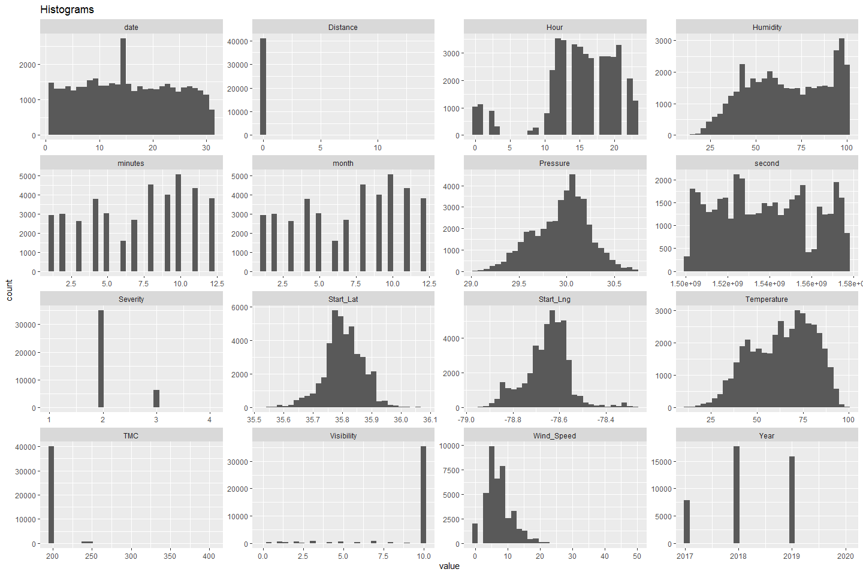
EDA :

Slide 8
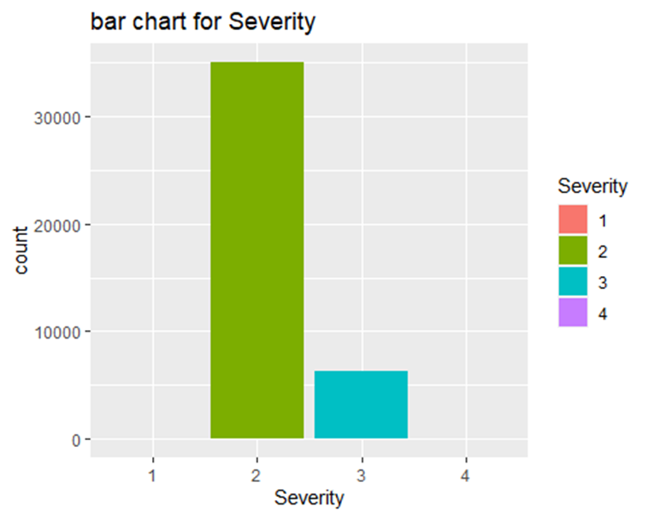
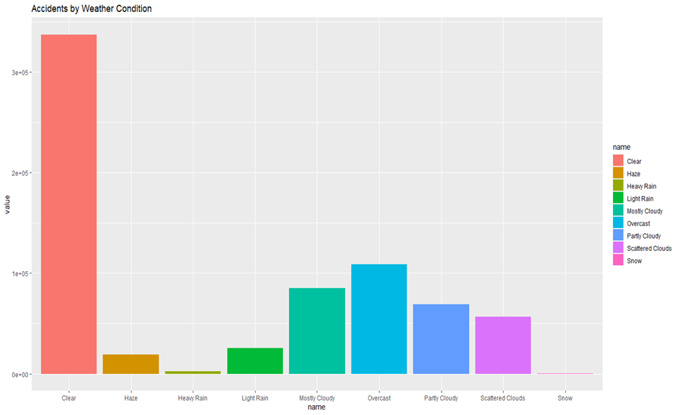
EDA:

Slide 9
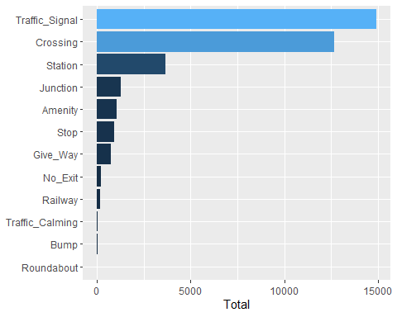
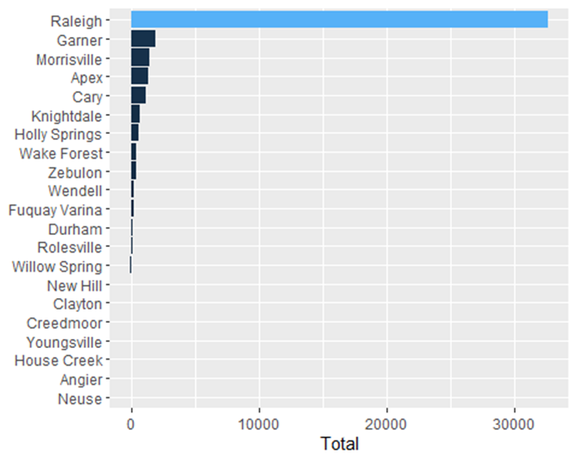
EDA:
Amount of accidents By road conditions
Amount of accidents per City

Slide 10
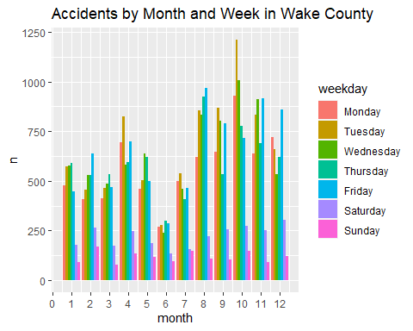
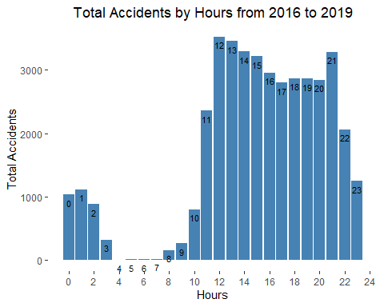
EDA:

Slide 11
Feature selection
Classified all 49 variables into the following categories
Location
Time
Weather
Road conditions
Amenities
Utilized knowledge from the previous step (data preparation) to finalize the features

Slide 12
Modelling
Used different modelling algorithms and compared the results.
GLM
Random Forest
GBM
Deep Learning
Stacked Ensemble

Slide 13
Model performance

Slide 14
summary
All models performed very well if we look at the overall accuracy. With GBM I was able to achieve the overall accuracy of 98.5% which is very good result at this time.
Since this is a multi-class classification problem, I would like to analyze the accuracy of my models in terms of sensitivity and specificity as well.
I would suggest to go with GBM which gave us extraordinary results in terms of accuracy as well as sensitivity.
One main problem I have observed with my data is that, the number of records are very low for low and extreme classes of the target variable which resulted in a class-imbalance problem for my data.

